Slide 1
Treadmill Scheduler Optimization
2017.08
Notes:
Hi, all. Let’s start. This is the presentation for the CIP project: Treadmill Scheduler Optimization.
I am Gao Ce, and this is 任老师

Slide 2
Outline
Problem
Idea
Implementation
Case Study
Evaluation
Future Work
Notes:
First, let‘s take a look at the outline. We will talk about the problem in the current architecture of treadmill scheduler, and the idea to solve the problem. Then I will introduce you to the architecture of the new scheduler framework. Besides this, there is a case study to show the functionality of the new framework. Then I will summary the presentation and list the progress of development. Finally, I will present the future work.

Slide 3
Problem
Configurability
Extensibility
Notes:
Configurability & Extensibility, these are two problems that we found in treadmill scheduler. There are some built-in strategies in the scheduler, for example, spread and pack. But it is hard coded and it is hard to configure or extend the logic of the scheduler.

Slide 4
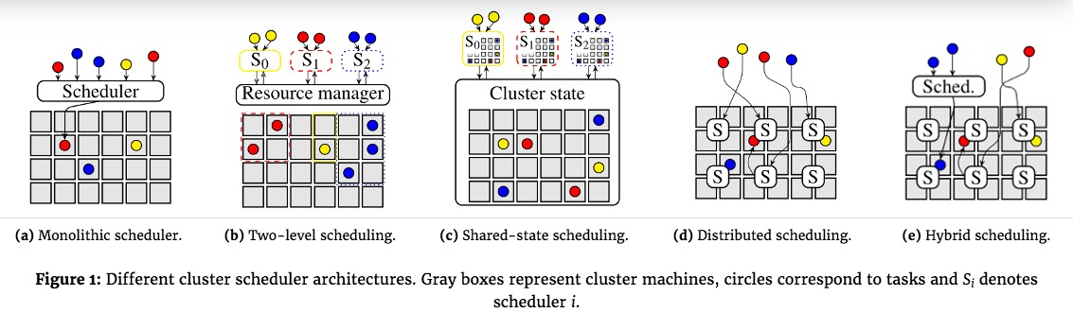
Idea
Implement a new scheduler framework:
extendable
configurable
Related projects or papers:
Google Kubernetes
Google Omega (EuroSys 13)
Apache Mesos (NSDI 11)
Apache Hadoop Yarn (SOCC 13)
Sparrow (SOSP 13)
Apollo (OSDI 14)
Hawk (ATC 15)
Mercury (ATC 15)
Firmament (OSDI 16)
Notes:
Then we want to implement

Slide 5
Idea

Slide 6
Idea

Slide 7
Implementation
Notes:
First, let‘s take a look at the outline. We will talk about the problem in the current architecture of treadmill scheduler, and the idea to solve the problem. Then I will introduce you to the architecture of the new scheduler framework. Besides this, there is a case study to show the functionality of the new framework. Then I will summary the presentation and list the progress of development. Finally, I will present the future work.

Slide 8
Implementation
Concurrency
Predicate in parallel
Priority in map-reduce pattern
Notes:
First, let‘s take a look at the outline. We will talk about the problem in the current architecture of treadmill scheduler, and the idea to solve the problem. Then I will introduce you to the architecture of the new scheduler framework. Besides this, there is a case study to show the functionality of the new framework. Then I will summary the presentation and list the progress of development. Finally, I will present the future work.

Slide 9
Case Study: Resource Fragmentation
4 Servers:
800M Failed Server
800M Server * 2
1700M Server

Slide 10
Case Study: Resource Fragmentation
5 Applications:
500M Application * 2
800M Application * 2
700M Application

Slide 11
Case Study: Resource Fragmentation
Native Scheduler: Spread

Slide 12
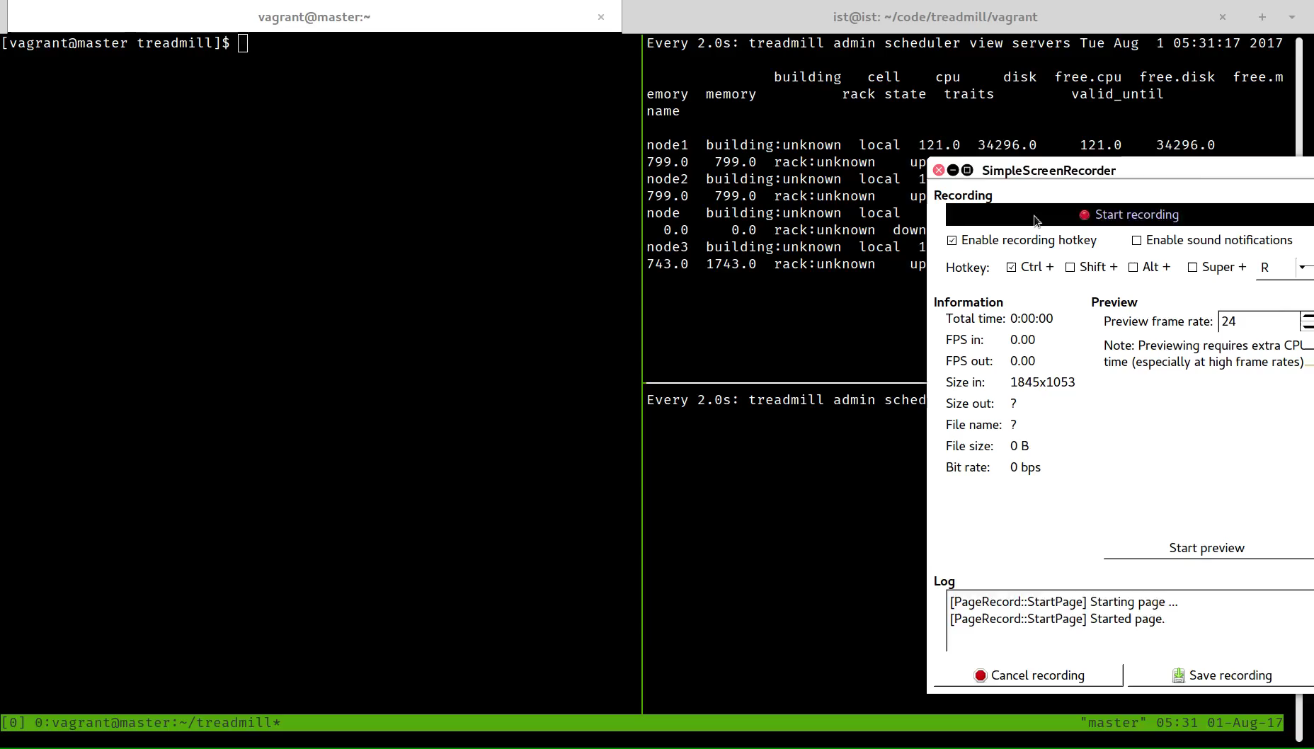
Case Study: Resource Fragmentation
Native Scheduler: Spread

Slide 13
Case Study: Resource Fragmentation
Custom Scheduler:
Predicates:
match_app_constraints
match_app_lifetime
alive_servers
keep_space
Priorities:
spread

Slide 14
Case Study: Resource Fragmentation
alive_servers: Filter the failed nodes
keep_space: Reject the applications which will come with resource fragmentation

Slide 15
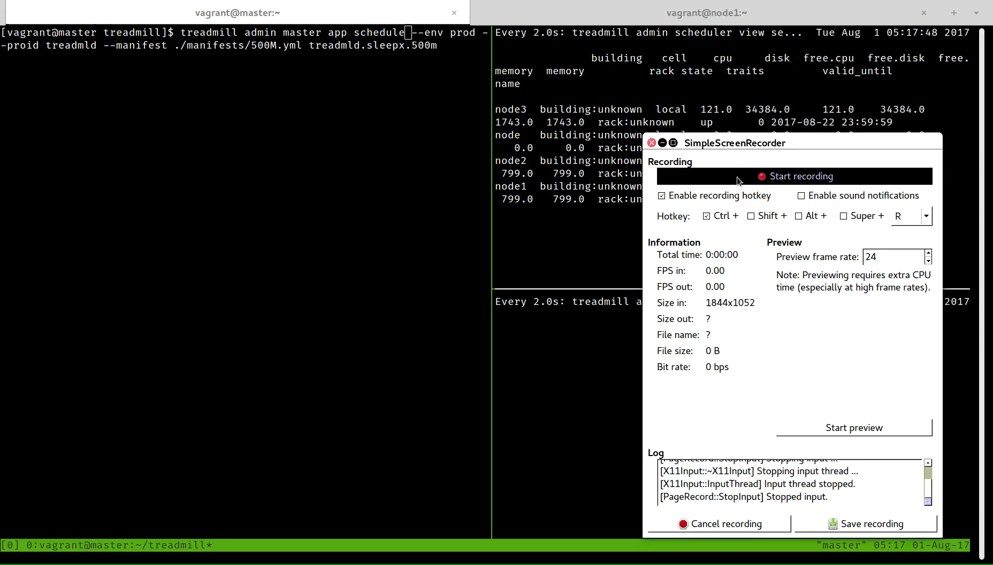
Case Study: Resource Fragmentation

Slide 16
Evaluation
It takes more time to schedule a job but it does not matter since the majority of jobs in treadmill are long-running.
More in our technical report

Slide 17
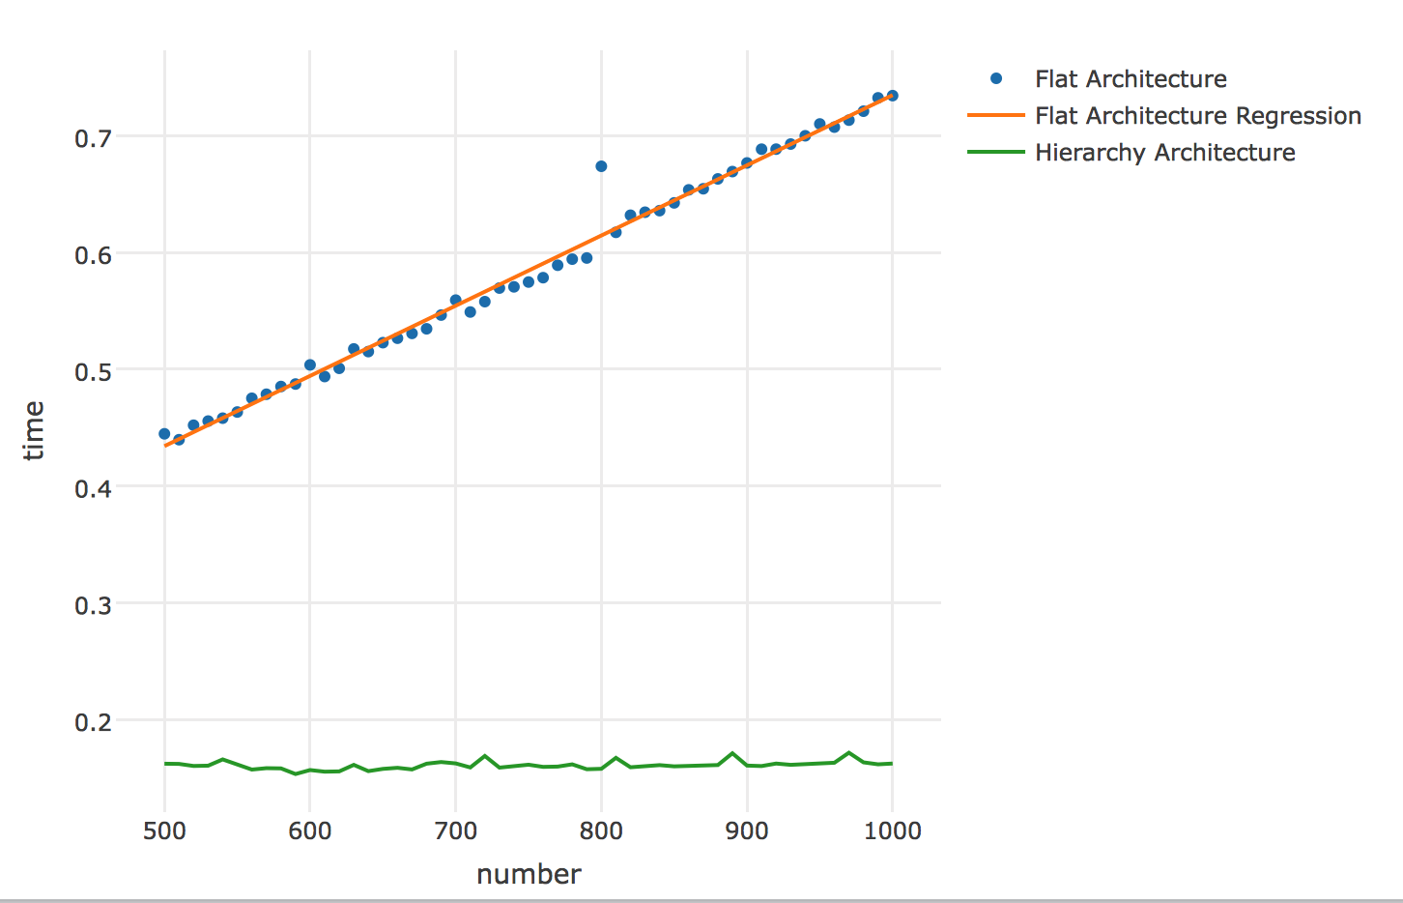
Evaluation
Notes:
Schedule 500 apps from 500 to 1000 nodes

Slide 18
Evaluation
It takes more time to schedule a job but it does not matter since the majority of jobs in treadmill are long-running.
More in our technical report

Slide 19
Progress of Development (Phase 1)
Start scheduler process in master, and start the necessary services in server. It can schedule and run apps but has some problems when the app should be cleanup. (History in GitHub)
Read related papers and code (Before Mar 7)
Try to run treadmill, use ApacheDS as LDAP server, but the code in public repo could not work. (Mar 7)
Try to run scheduler process in master separately. Remove LDAP. (Mar 13)
Use `./bin/treadmill --debug admin master server configure` and `./bin/treadmill --debug admin master app schedule` to allocate server and app. (Mar 17)
Import vagrant, and use bash script to start network service, cgroup service and local disk service in server side. Init server with `./bin/treadmill sproc init`, instead. (Mar 20)

Slide 20
Progress of Development (Phase 1)
Hack eventmanager (Mar 22)
Hack app config manager(Apr 6)
Hack supervisor (Apr 12)
Add set up script to set up the environment in vagrant VM. And do some hacks to run server without errors (Apr 22)
Fix some bugs in local-up bash script, and run rrdcached in server side (Apr 24)
Add bash script to export environment variables (May 4)

Slide 21
Progress of Development (Phase 2)
Try to use vagrant maintained by TW, but it does not work well. Start to write benchmarks and simulator for treadmill scheduler, and use R Language Notebook to present the result. (History in GitHub)
Implement the first benchmark. (May 19)
Record the result of the benchmark, and profile scheduler. Show the result in R Language Notebook. (June 1)
Add two benchmarks (June 5)
Generate technical report (June 15)
Fix bugs in the graph (June 22)

Slide 22
Progress of Development (Phase 3)
Implement the core logic of the new scheduler framework (History in GitHub)
Add configuration logic of the scheduler, which is the main functionality of the scheduler framework (July 10)
Add predicates and priorities support (July 11)
Fix the bug about application placement in the server (July 12)
Hack the Cron API to allow users to call `treadmill admin invoke` (July 14)
Fix test_affinity_limits case and refactor the logic about flatten nodes (July 15)
Add CLI options to switch the type of scheduler and move code about algorithm to plugins and add CLI options to pass configurations to the new scheduler (July 16)
Update technical report (July 19)
Fix all test cases (July 22)
Separate the new test cases with the old (July 24)
Refactor the code about affinity limits (July 25)

Slide 23
Future Work
Monitor
Customization
Advanced Features
Hybrid Scheduler

Slide 24
Monitor
Basis of many features:
Resource Oversubscription
Fine-grained and Precise Scheduling
Application Lifecycle Management

Slide 25
Scheduler Customization
Runtime Configurability
Keep the configuration in ZooKeeper and watch the configuration to update
Extendable Architecture
HTTP Extender
But hurt the scheduler latency and throughput

Slide 26
Advanced Scheduler Features
Affinity, Inter-Affinity & Anti-Affinity Scheduling
More expressive than label
More flexible
Affinity
Scheduling an application on to a node
Inter-affinity
Co-locating applications on a same node on account of some reasons, for example dependency, network latency.
Anti-affinity
Spreading applications on different nodes

Slide 27
Hybrid Architecture
Centralized with distributed
Centralized scheduling for long-running jobs
Distributed scheduling for short jobs

Slide 28
A lot of other features...
Suboptimal scheduling
Concurrent schedulers with different names
Resource arbitration to solve potential conflicts
Scheduling based on min-cost max-flow optimization
...

Slide 29
Acknowledgments
Thank Walt and Xincheng for their guidance.

Slide 30
Thanks

